Slide 1

Pay Progression
Live 1st August 2022

Slide 2

What is Pay Progression
To change the photo, left click it and press backspace to delete it.
You’ll get a grey shape instead.
Left click the icon in the centre, to open Explorer, and you can find the picture you’d like to insert.

Slide 3
What is Pay Progression
To change the photo, left click it and press backspace to delete it.
You’ll get a grey shape instead.
Left click the icon in the centre, to open Explorer, and you can find the picture you’d like to insert.

Slide 4
Changes to banding
To change the photo, left click it and press backspace to delete it.
You’ll get a grey shape instead.
Left click the icon in the centre, to open Explorer, and you can find the picture you’d like to insert.

Slide 5
Band 1 removed 2019
Removal of band 1

Slide 6
Criteria to be satisfied

Slide 7
Pay Step Submission Process

Slide 8
Pay Step Review Meeting
Different to appraisal

Slide 9
Paperwork

Slide 10
Delayed Pay Step

Slide 11
Appeal process

Slide 12
Appraisal

Slide 13
Re-earnable process for bands 8C and above

Slide 14
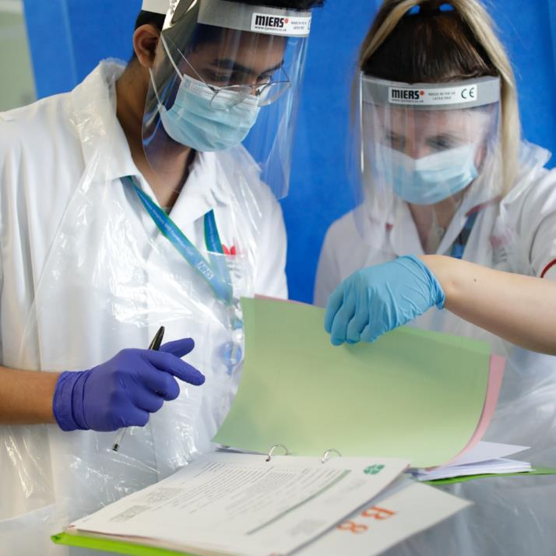
Section Break
(option 1)
This section contains the following:
More points
or details
here

Slide 15

Section Break
(option 2)
This section contains the following:
More points
or details
here

Slide 16
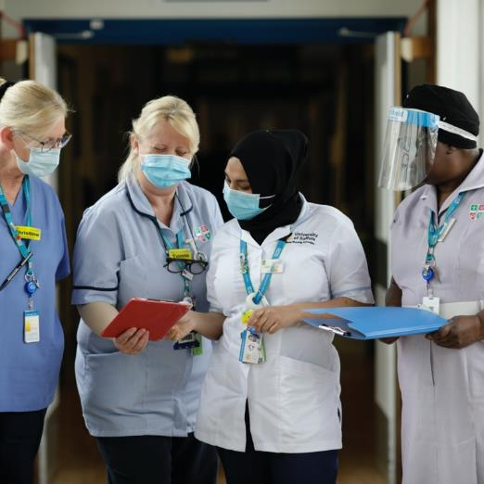
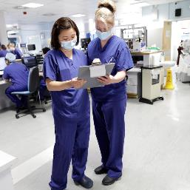
Two-picture text slide
To change the photo, left click it and press backspace to delete it.
You’ll get a grey shape instead.
Left click the icon in the centre, to open Explorer, and you can find the picture you’d like to insert.

Slide 17

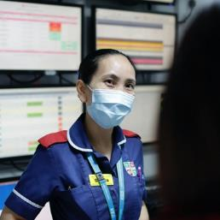
Two-picture text slide
To change the photo, left click it and press backspace to delete it.
You’ll get a grey shape instead.
Left click the icon in the centre, to open Explorer, and you can find the picture you’d like to insert.

Slide 18
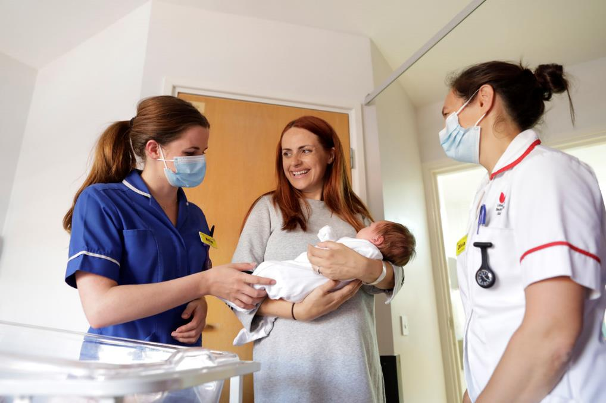
One-picture text slide (standard format)
To change the photo, left click it and press backspace to delete it.
You’ll get a grey shape instead.
Left click the icon in the centre, to open Explorer, and you can find the picture you’d like to insert.

Slide 19
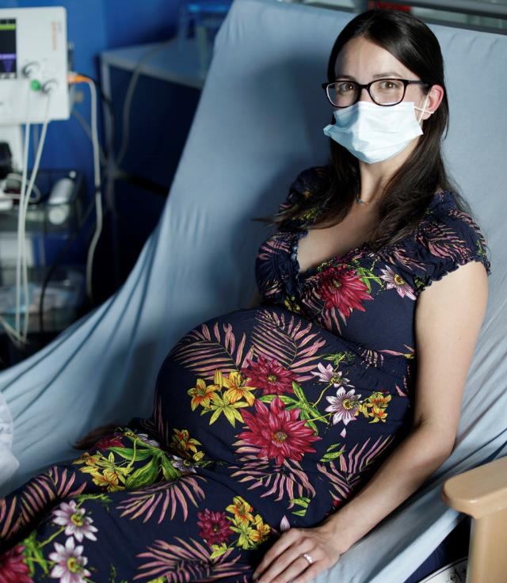
One-picture text slide (standard format)
To change the photo, left click it and press backspace to delete it.
You’ll get a grey shape instead.
Left click the icon in the centre, to open Explorer, and you can find the picture you’d like to insert.

Slide 20
Blank Text Only Slide
If you need more room for lots of text, this slide has no pictures
  Bullet point style
More points…

Slide 21
Title
Table | Format

Slide 22
Colours
These are the colours on our corporate palette – they’re the same as the main NHS brand.
If you’d like to use different colours, you should use the those on the top two rows first, then the ones below if you need.
Please refer to the brand guidelines if needed.

